Slide 1


LUSTRE - Lower Urban Speed Limits in Europe”. How has reducing speed limits changed the roads in Europe?
Richard Owen

Slide 2
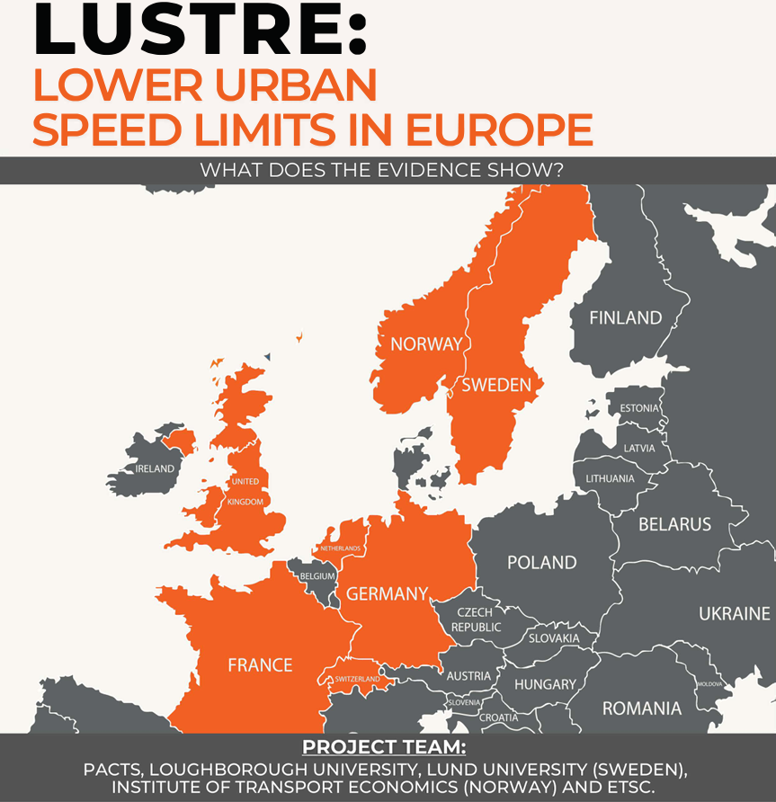


Notes:
It’s a pleasure to present to the whole ETSC council
Back in 2020 PACTS lead a research project to investigate the safety benefits of lower urban speed limits
the work was based on previous records some dating back to the 1980s and referenced 6 countries in mainland Europe
since then there have been more extensive initiatives brought out across cities in Europe and one of them across all urban areas in the country of Wales
in this presentation I'll start by focusing on the specific project by pacts then give some early results from Wales and conclude with a broader look at ongoing changes in Europe.

Slide 3
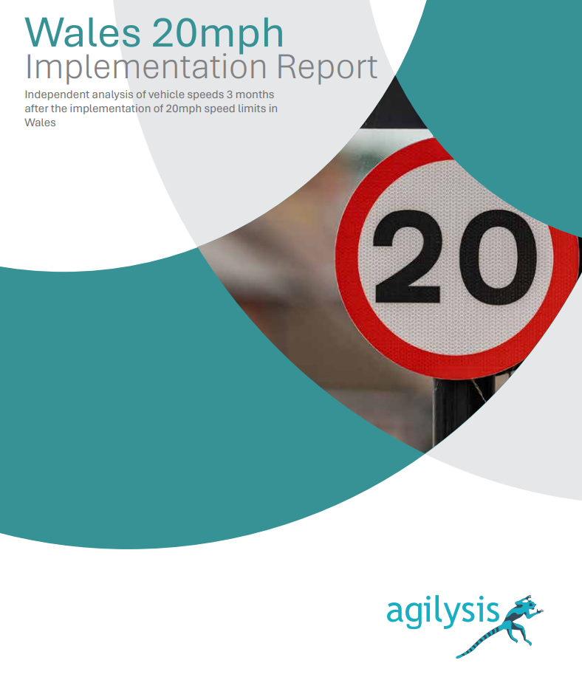
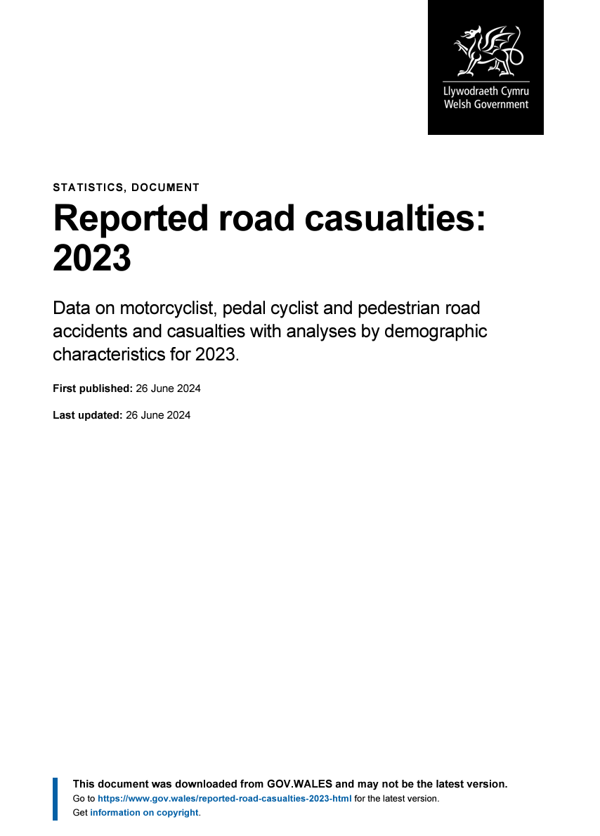

Slide 4
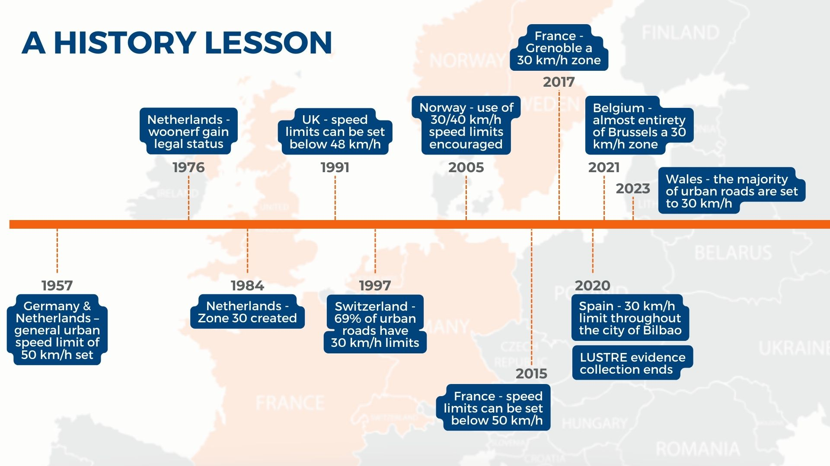
www.pacts.org.uk
Safe transport for all
Notes:
These show the findings from the LUSTRE report where, since 1957 – Germany & Netherlands, a general urban speed limit of 50km/h set
Over the last nearly seventy years countries have developed their own speed limit policies
Each one of you will be familiar with the way in which your own country is taking measures
Lower speed limits (20mph/30kph) in towns and villages are now internationally-endorsed as a key element in reducing road casualties.
At 20 mph a pedestrian is likely to survive an impact with a motor vehicle whereas at 30 mph the pedestrian is significantly more likely to be killed.
Traffic speeds of around 20 mph are also more conducive to walking and cycling.
How are lower vehicle speeds achieved?

Slide 5

www.pacts.org.uk
LUSTRE: Lower Urban Speed Limits in Europe
Project overview report
USING….
DITION IT INCLUDES:
Development of UK policy on 20 mph speed limits, by PACTS (Evan Webster, David Davies and Margaret Winchcomb)
Summary of European speed limit case studies, by Christer Hydén, Lund University, Sweden
Paper assessing the methodological quality of studies evaluating low speed limits
by Dr Rune Elvik, TOI, Norway.
Meta-analysis of the effect of 20 mph speed limits in the UK
by Loughborough University (A Theofilatos, M. Quddus and M Feng)
Safe transport for all
Notes:
The LUSTRE project set out to analysis speed limit setting policy and methods in the UK and in six countries in mainland Europe.
Within the UK a meta-analysis of the effects of 20 mph limits, based on 24 previous reports on the impacts of 20mph limits was carried out
In Europe countries which have similarities to the UK, either in terms of size or road safety performance were selected - Norway, Sweden, Germany, The Netherlands, France and Switzerland
The report also includes an appendix of guidance on evaluating the effects of changes in low-speed limits
Thank the LUSTRE project team, an international group of road safety experts

Slide 6
www.pacts.org.uk
LUSTRE: Lower Urban Speed Limits in Europe
The project set out to ask:
USING….
DITION IT INCLUDES:
Where lower urban speed limits have been set in Europe, what does the evidence show?
What are the implications of setting posted speed limits without physical measures?
Evidence gathered included:
24 UK studies
Reports from six other European countries which have similarities to the UK, either in terms of size or road safety performance
The project team included:
The Parliamentary Advisory Council for Transport Safety (PACTS) - Evan Webster, David Davies and Margaret Winchcomb
Loughborough University - A Theofilatos, M. Quddus and M Feng
Lund University (Sweden) - Christer Hydén
Institute of Transport Economics (Norway) - Dr Rune Elvik
The European Transport Safety Council (ETSC) – Jenny Carson
Safe transport for all
Notes:
The LUSTRE project set out to analysis speed limit setting policy and methods in the UK and in six countries in mainland Europe.
Within the UK a meta-analysis of the effects of 20 mph limits, based on 24 previous reports on the impacts of 20mph limits was carried out
In Europe countries which have similarities to the UK, either in terms of size or road safety performance were selected - Norway, Sweden, Germany, The Netherlands, France and Switzerland
The report also includes an appendix of guidance on evaluating the effects of changes in low-speed limits
Thank the LUSTRE project team, an international group of road safety experts

Slide 7

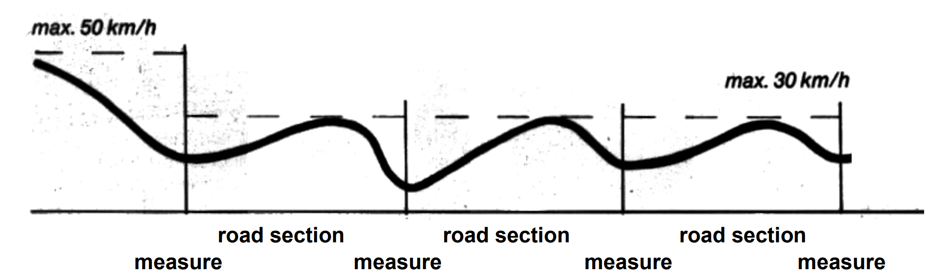
www.pacts.org.uk
Physically enforcing lower urban speed limits
Physical speed restricting measures include:
inconvenience (humps)
a forced deviation of course (slalom)
narrowing of the carriage way
credit: 1982, The Netherlands, Ministry of Transport
Safe transport for all
Notes:
In the UK in the 1990s 20mph zones were introduced
the specific condition of these areas was that they should be self enforcing
There was typically a 40% reduction in casualties
therefore including speed humps slaloms marrying of carriage way etc
we found in the LUSTRE report that the Netherlands, Norway and Switzerland tend to include physical engineering
In 2013 in the UK the government’s Department of Transport decided to make guidance more flexible
so local authorities were given the freedom to introduce 20 hour limits based on average speeds and the requirement for self enforcing physical message was eased
as a result 20 mile an hour limits are now generally introduced with very few physical measures
it may be easier less contentious and less costly for local authorities to install but the question was from this report would these bring speeds down?

Slide 8
www.pacts.org.uk
Features of the study areas
Were all roads 30km/h / 20 mph?
The six European countries studied have had different approaches to implementing speed limits. For example, in Germany physical measures are less likely to be constructed while in Switzerland they are widespread.
As far as we are able to tell, in the six countries studied, a high proportion of residential areas have 30 km/h limits. Almost all streets that have 30 km/h today are small residential streets.
However, main arteries in built-up areas, carrying the majority of motor traffic and the biggest burden in terms of collisions and injuries, retain 40 or even 50 km/h limits.
Significant debate on which roads should be subject to higher speed limits to balance characteristics of movement and place
By how much were injury collisions reduced?
By how much were KSIs reduced?
Safe transport for all
Notes:
The studies show a downward movement in measured speeds and resultant casualties
where slower speed limits are introduced the scale was hard to assess
the magnitude varied
however the general commonality between the UK and the six European case studies was a reduction of one to two miles an hour at where speeds were approximately 25 mph beforehand
Compliance with 20 mph limits without physical measures is poor.
For the European case studies, there were too few studies of sign only schemes to provide an average.
The conclusion is that 20 mph limits with physical measures have substantially greater speed and casualty reduction effects than those without.
Might there be other ways to bring about a wider change?
The studies above were based on small local schemes.
Other policy areas are supporting road safety meaning larger areas are being covered with reduced speed limits.
There are wider aims to change the way people travel
In the country of Wales to bring about improved well-being, accessibility, air quality, and improvements to the economy as well.

Slide 9
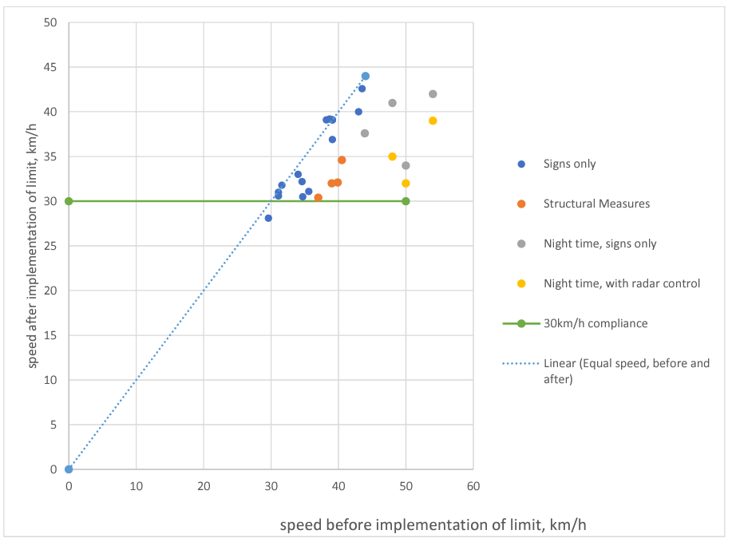
www.pacts.org.uk
Signs vs Physical Mesures
Was there a difference?
There is a distinct difference between the impact of speed limits accompanied by physical measures and those implemented with ’signs only’. The latter represents by far the largest group of studies and although ’signs alone’ produce a reduction in speed, it is less pronounced.
The effect of accompanying ‘sign-only’ schemes with education and campaigns has little further impact and, in practice, enforcement is too difficult to employ on a large scale
By how much were injury collisions reduced?
By how much were KSIs reduced?
Safe transport for all
Notes:
The studies show a downward movement in measured speeds and resultant casualties
where slower speed limits are introduced the scale was hard to assess
the magnitude varied
however the general commonality between the UK and the six European case studies was a reduction of one to two miles an hour at where speeds were approximately 25 mph beforehand
Compliance with 20 mph limits without physical measures is poor.
For the European case studies, there were too few studies of sign only schemes to provide an average.
The conclusion is that 20 mph limits with physical measures have substantially greater speed and casualty reduction effects than those without.
Might there be other ways to bring about a wider change?
The studies above were based on small local schemes.
Other policy areas are supporting road safety meaning larger areas are being covered with reduced speed limits.
There are wider aims to change the way people travel
In the country of Wales to bring about improved well-being, accessibility, air quality, and improvements to the economy as well.

Slide 10
Notes:
SPEEDS BEFORE AND AFTER THE IMPLEMENTATION OF 30 KM/H LIMITS IN EUROPEAN LOCATIONS NOTE: CLOSER PROXIMITY TO THE DIAGONAL TREND LINE INDICATES SMALLER REDUCTION IN SPEED, CLOSER PROXIMITY TO THE HORIZONTAL TREND LINE INDICATES COMPLIANCE WITH THE 30 KM/H LIMIT

Slide 11
www.pacts.org.uk
The result of speed limits without physical changes
By how much did speeds reduce?
20 mph limits without physical measures
before speeds are approximately 25 mph, speed down 1-2 mph (2-3km/h)
before speeds are approximately 30 mph, speed down 3-5 mph(5-8km/h)
compliance with 20 mph limits without physical measures is poor.
By how much were injury collisions reduced?
in the UK - 11% fewer casualties than before
for all schemes, including some with physical measures, there were approximately 18% fewer casualties after 30 km/h limits were introduced
By how much were KSIs reduced?
Safe transport for all
Notes:
The studies show a downward movement in measured speeds and resultant casualties
where slower speed limits are introduced the scale was hard to assess
the magnitude varied
however the general commonality between the UK and the six European case studies was a reduction of one to two miles an hour at where speeds were approximately 25 mph beforehand
Compliance with 20 mph limits without physical measures is poor.
For the European case studies, there were too few studies of sign only schemes to provide an average.
The conclusion is that 20 mph limits with physical measures have substantially greater speed and casualty reduction effects than those without.
Might there be other ways to bring about a wider change?
The studies above were based on small local schemes.
Other policy areas are supporting road safety meaning larger areas are being covered with reduced speed limits.
There are wider aims to change the way people travel
In the country of Wales to bring about improved well-being, accessibility, air quality, and improvements to the economy as well.

Slide 12
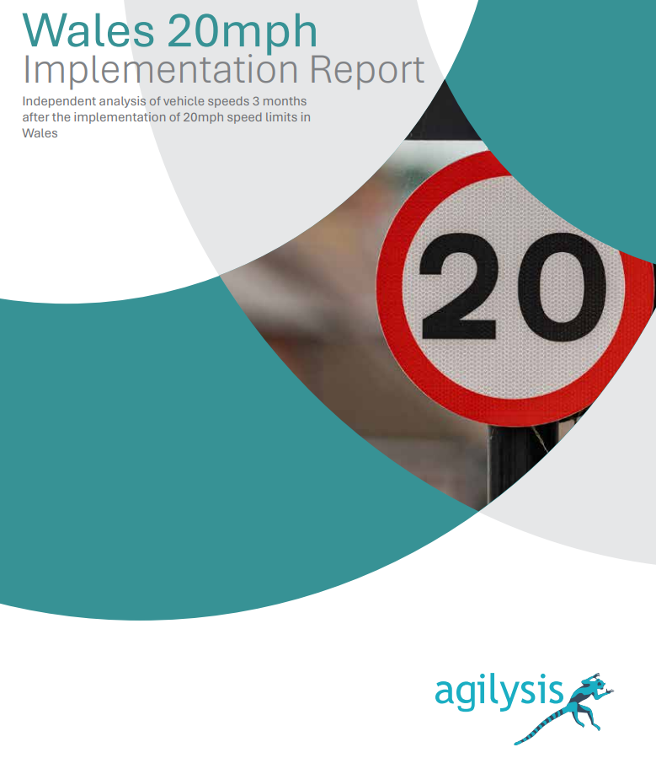
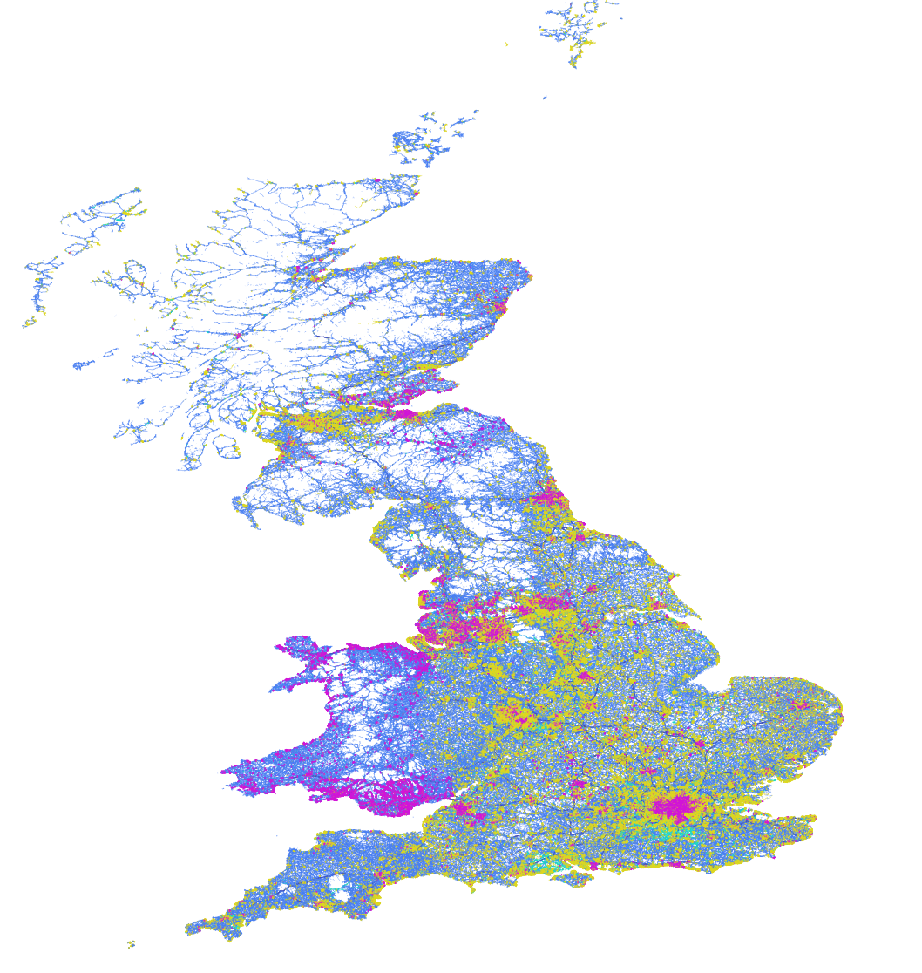

Slide 13
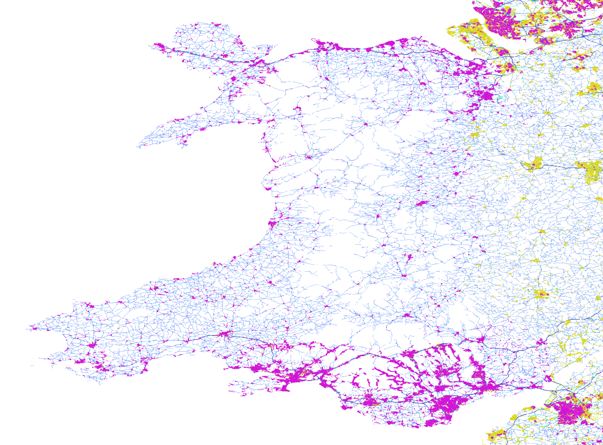

Slide 14
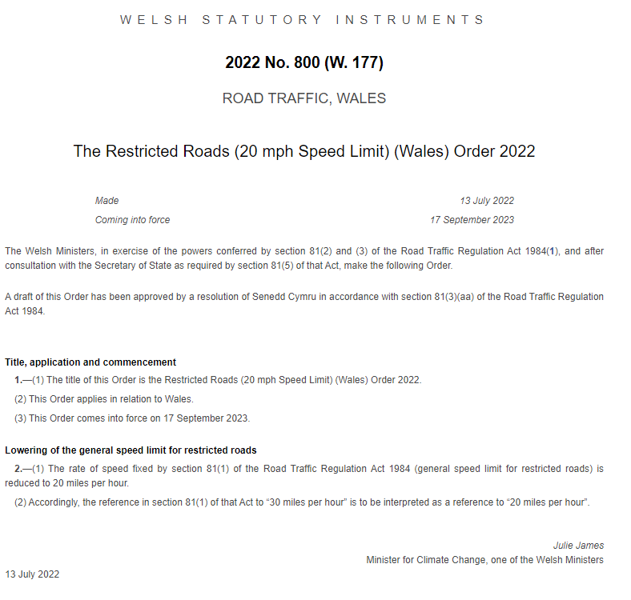
Wales 20mph Implementation
Welsh Government decision to change the default urban speed limit (restricted roads) to 20mph.
Largest scale change in the UK,
Opportunity to see how useful new data sources are in measuring immediate impacts on speeds

Slide 15
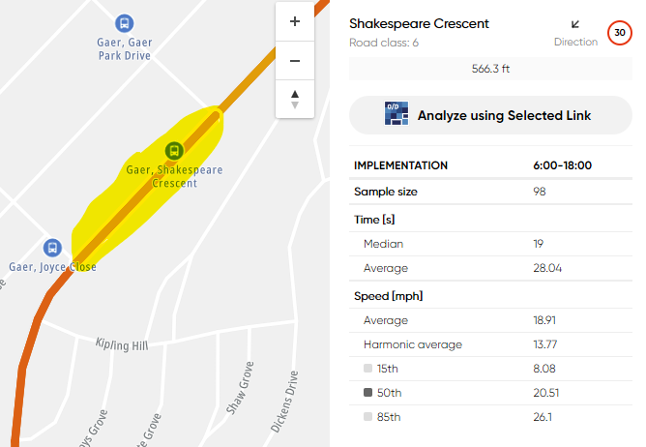
Wales 20mph Implementation
Mon 11th – Fri 15th Sept
Mon 18th – Fri 22nd Sept
6am – 6pm
Sample size >=100 in both periods
50th percentile speed (median)
https://youtu.be/KrpY_TL-q9Q?si=TqJe5bZUN81hrdAp
Notes:
In statistics there are various measures that allow us to represent the characteristics of a group. For us the group is vehicles and the characteristic is vehicle speed along individual road sections.
One of the most commonly used statistical measures is the mean (the ‘arithmetic mean’ to be precise, but more often simply termed the ‘average’). The mean is the sum of the characteristics of the group (e.g. individual observed speeds) divided by the number in the group.
However, when we wish to describe the central tendency of the group, the mean is not always the most appropriate measure – unless you have an equal distribution in the sample. For example, if the group contains some elements with exceptionally high speeds, these will push the arithmetic mean well above the central tendency of the group.
To represent the central tendency of a group, median is perhaps the appropriate statistical measure, and is the one selected in the DfT Atkins report I mentioned earlier. The median is found by ordering the group characteristics in ascending value and selecting the middle one. It’s represented here by the 50th percentile.

Slide 16

Wales 20mph Implementation
Ordered data within 24 hours
Imported data into GIS software, processed and matched
Export speed data to Excel for analysis
Excluded low-sample roads
Calculated a weighted average based on sample size
Almost 60 million vehicle movements in the sample
$$\text{WeightedSpeed} = \frac{Σ\text{SampleSize} ⋅\text{Distance} ⋅\text{MedianSpeed}}{Σ\text{Distance} ⋅\text{MedianSpeed}}$$

Slide 17
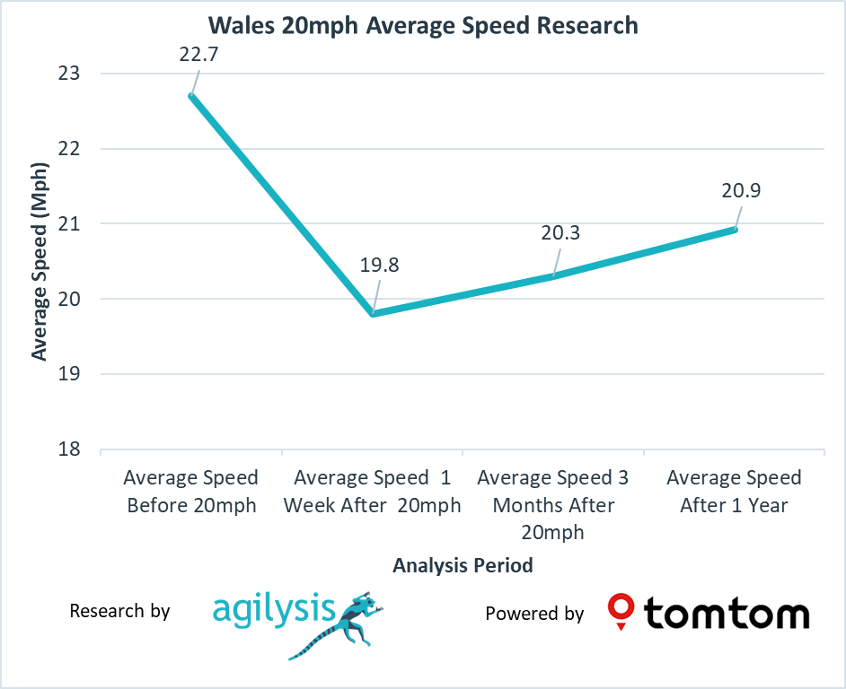
Wales 20mph Implementation

Slide 18
Wales 20mph Implementation
Other Data
Welsh Government analysis of speeds on faster roads show a 4.3mph reduction in speeds.
In Q4 2023 there were 32% fewer casualties on 20 / 30 mph roads than in Q4 2022.
In Q1 2024, that comparison with Q1 2023 showed a decrease of 26%.
Early indications are that casualty reductions are in line with predictions from various models based on observed speed values
Vehicle damage claims in Q4 2023 from Esure Insurance are 20% lower than expected

Slide 19
Thank you
Richard Owen
richard.owen@agilysis.co.uk

